Slide 1
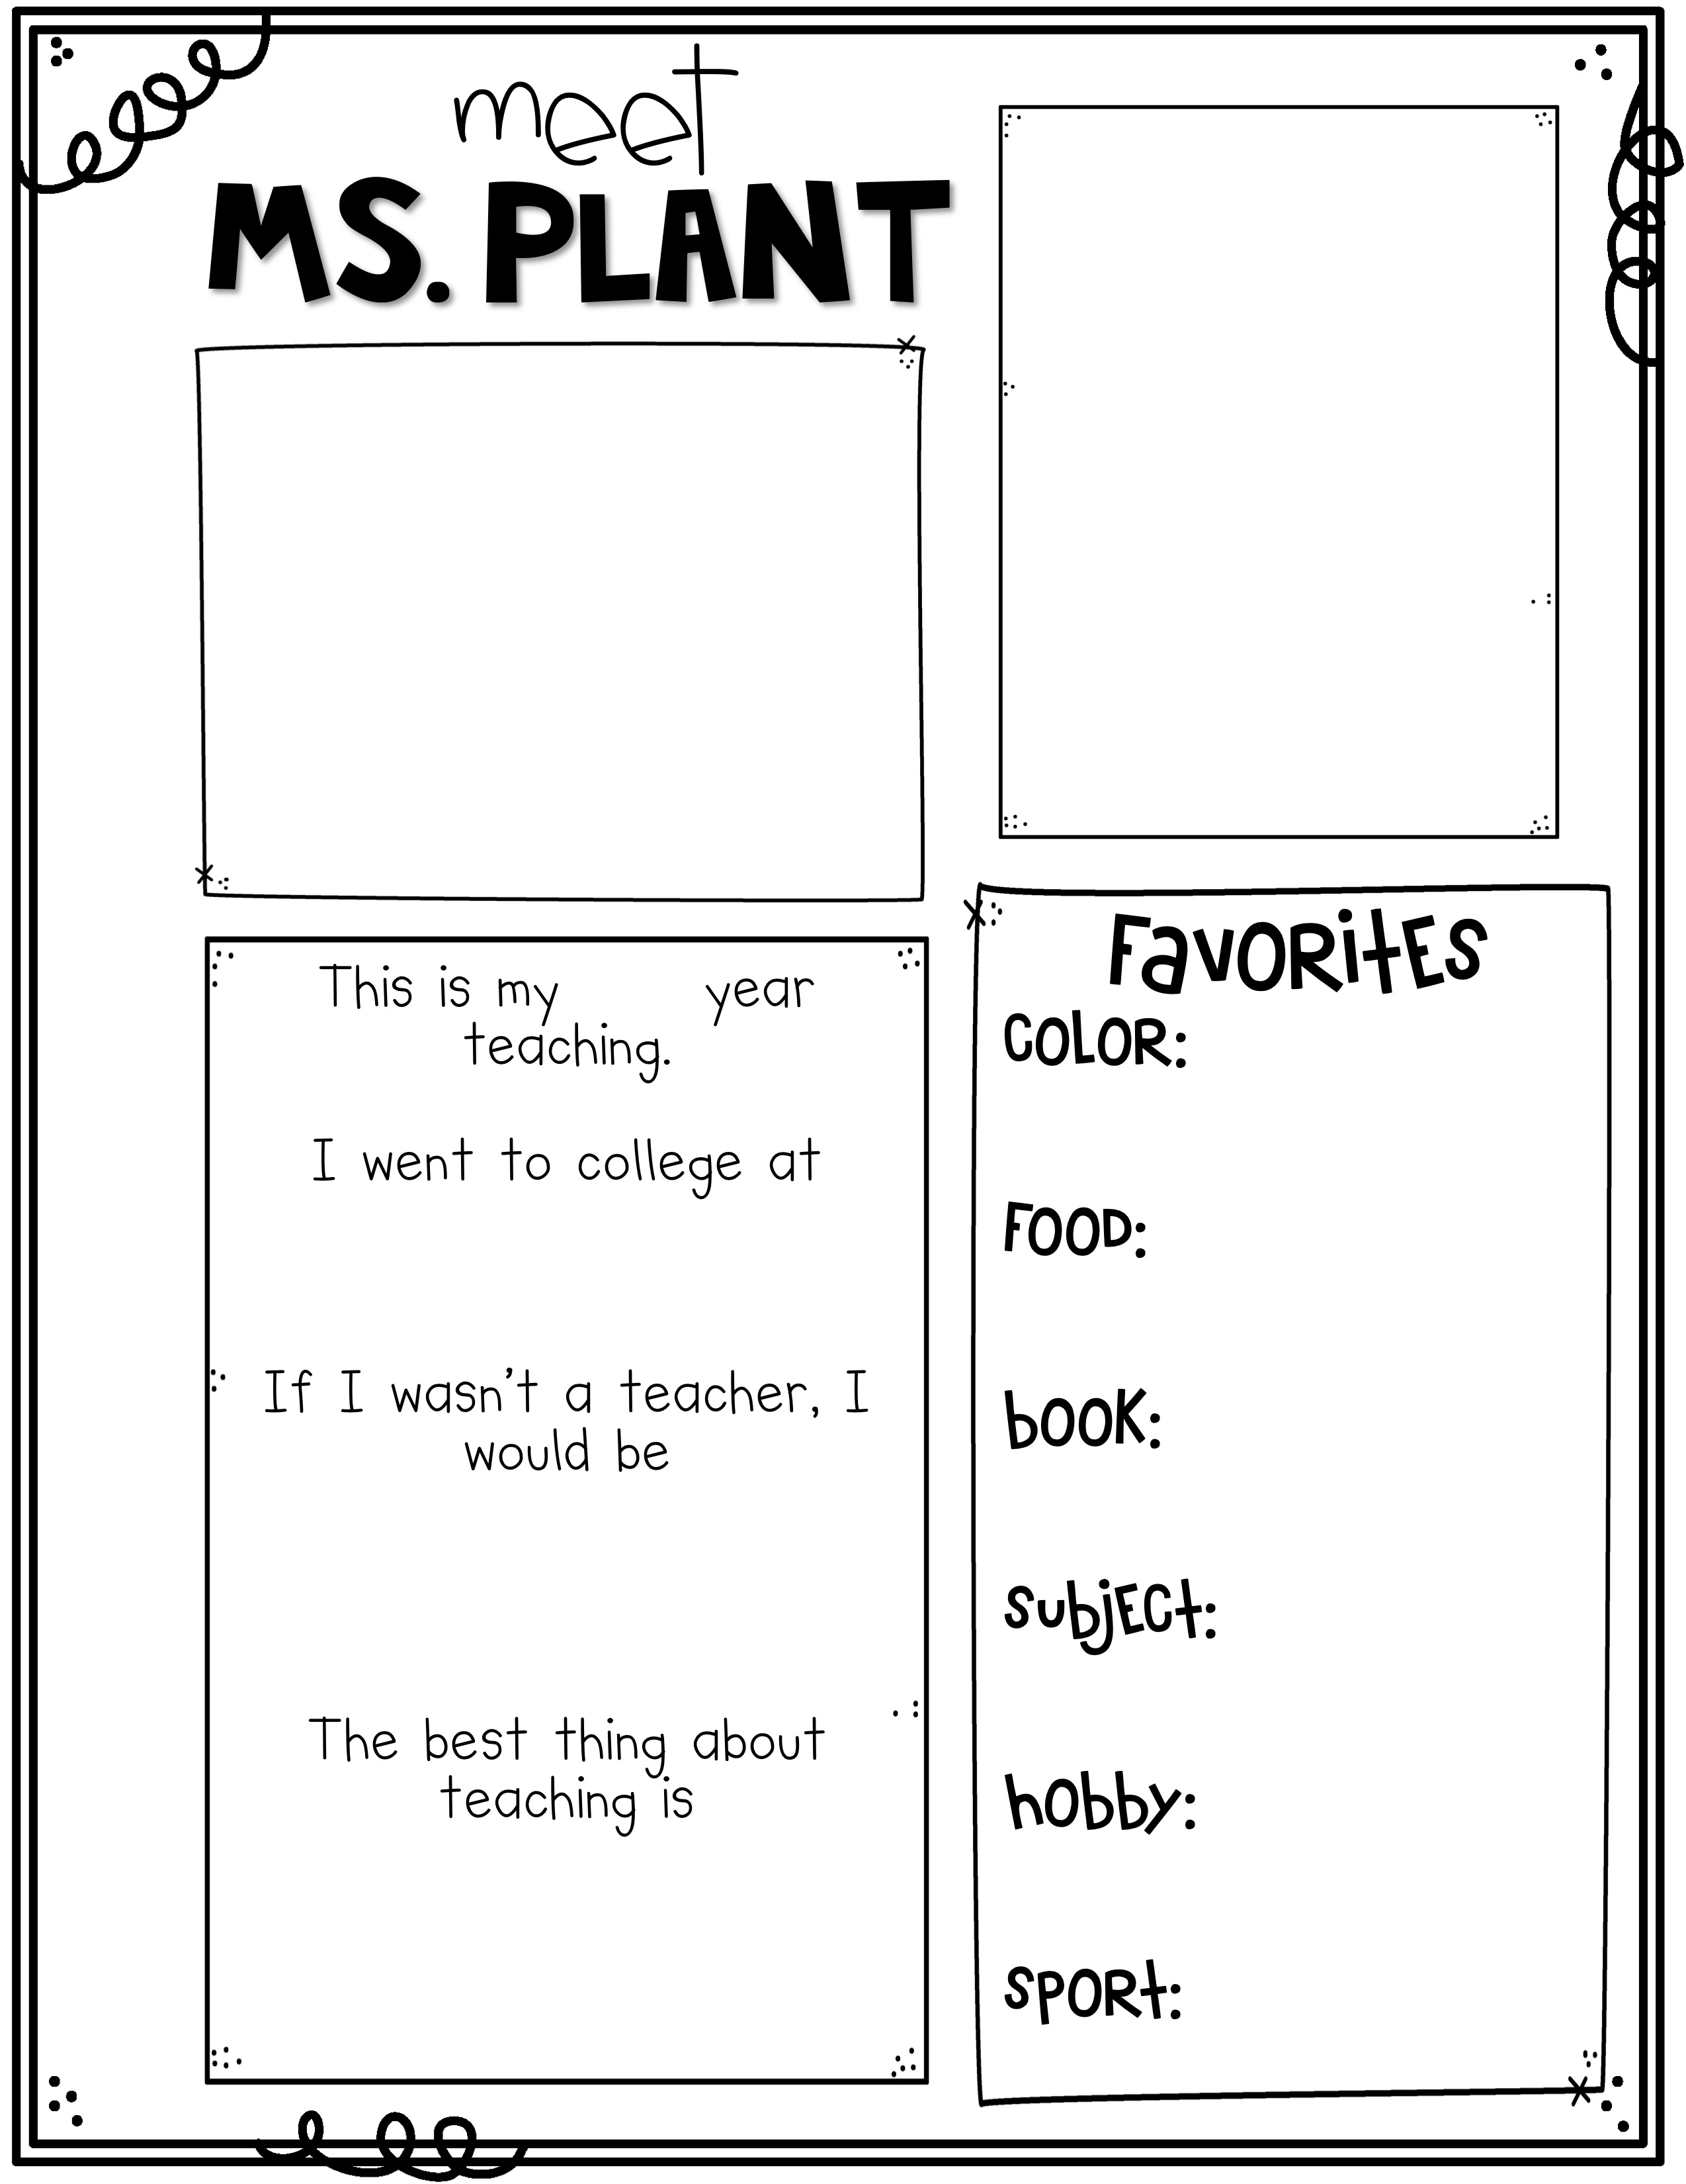
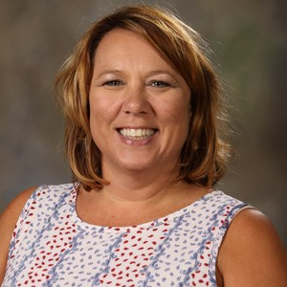
K
i
n
d
e
r
g
a
r
t
e
n
R
e
a
d
i
n
e
s
s
Mrs. Pantall
insert picture
here
28th
Yellow
Ice Cream
Middle Tennessee State University
The Giving Tree
A librarian
Math
Reading
that it matters.
The hardest part is that every moment matters every day.
Shopping

